Slide 1
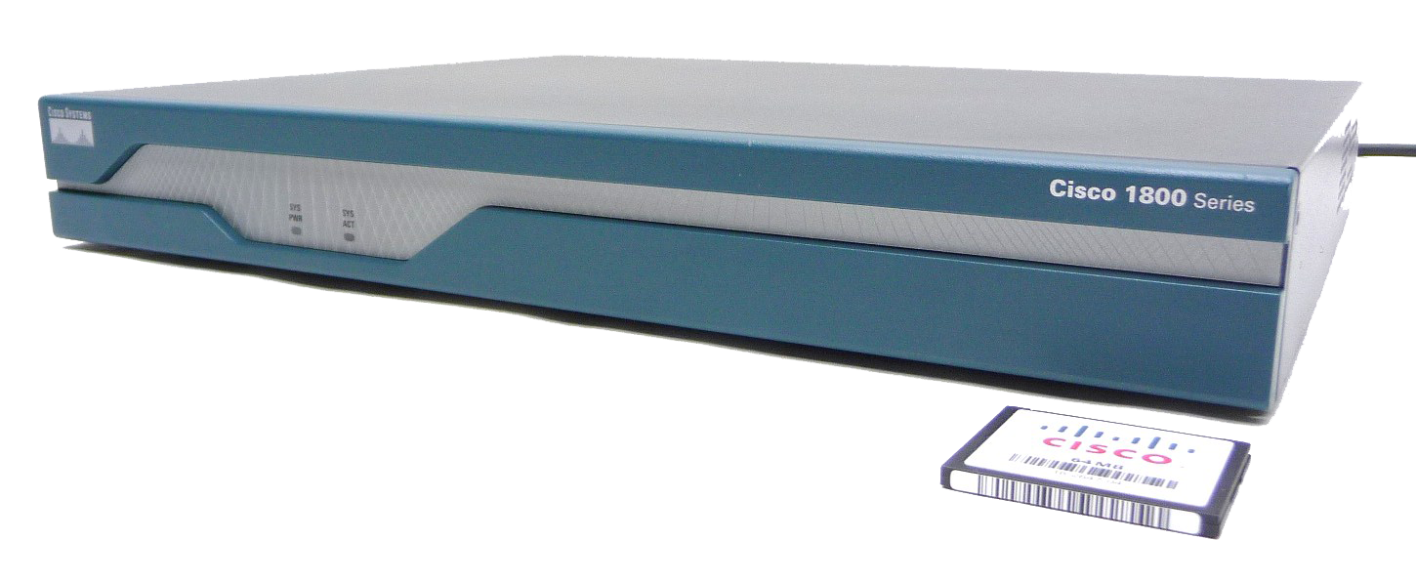
ANALYSIS STUDY OF VIRTUAL PRIVATE NETWORK ON CISCO 1841 ROUTER
IWAN CHANDRA
207115684
Notes:
Good afternoon ladies and gentleman, my name is Iwan Chandra, student ID is 207115684 (two o seven eleven five six eight four)
Today I will present my final project which titled ******
Cisco Eighteen forty one router

Slide 2
Main Points
Backgrounds
Objective
Scope
Virtual Private Network
IPsec
Implementation on ADSL
Analysis Study
Result
Conclusion

Slide 3

Backgrounds
The need for a network that provides privacy between the two networks
The use of a comparatively cheap Internet cost, but insecure
Many methods of VPN implementation
Notes:
As you can see, the internet traffic can be described as a opened truck which the content is visible for everyone which being in the traffic instead

Slide 4
Objective
Implementing VPN to establish a private network on a Wide Area Network using Cisco 1841 Router and ADSL Connection.
Analyze the security system and performance between networks using VPN to a network without a VPN.

Slide 5
Scope
Use Cisco 1841 as VPN Gateway and IPsec as Security Protocol
Implementing ADSL Connection for the case study
Analyzing the security of VPN combination using a Simulated WAN

Slide 6
What is VPN?
VPN is a technology for using the Internet or another intermediate network to connect computers to isolated remote computer networks that would otherwise be inaccessible. A VPN provides security so that traffic sent through the VPN connection stays isolated from other computers on the intermediate network.

Slide 7
Why use VPN?
Cheaper than building a private line
Provides security as a private line does
Ease in network expansion
Compatible with existing broadband technologies

Slide 8

VPN Protocols
PPTP – Point to Point Tunneling Protocol
L2TP – Layer 2 Tunneling Protocol
MPLS – Multi Protocol Label Switching
IPsec – Internet Protocol Security
Notes:
VPN can be described as a closed container truck that the contents is cannot be seen by everyone, except the sender and receiver. That’s why it called “secured”

Slide 9
IPsec
Internet Protocol Security (IPsec) is a protocol suite for securing Internet Protocol (IP) communications by authenticating and encrypting each IP packet of a communication session. IPsec also includes protocols for establishing mutual authentication between agents at the beginning of the session and negotiation of cryptographic keys to be used during the session.

Slide 10
IPsec Components
IPsec Protocol
Confidentiality
Integrity
Authentication
Diffie-Hellman
Notes:
IPsec protocol – the protocol used by IPsec (ESP and ESP+AH)
Confidentiality – to secure the data by encrypting the original data
Integrity – to ensure the received data is the same as the sent data
Authentication – to authenticate the targeted peers which will communicate between the tunnel
Diffie-Hellman Algorithm – that used to encrypt the IKE proposals between the peers

Slide 11
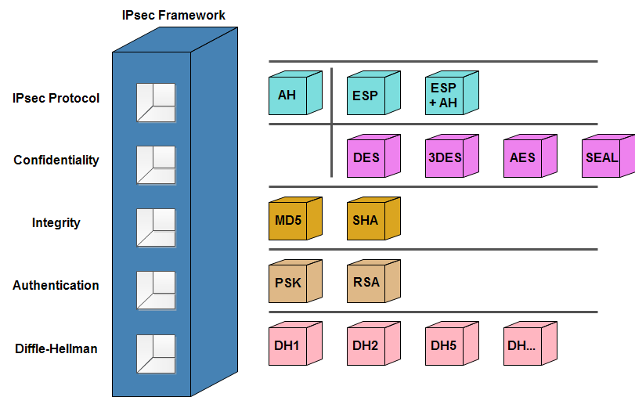
Why IPsec?
Have a security framework that can be modified in accordance with the desired security requirements.

Slide 12
Why IPsec?
Easier implementation than other protocols
Supports all existing modes

Slide 13
How IPsec works?

Slide 14
How IPsec works?
IPsec encrypt the original package which contain IP Header and Data, then added with ESP trailer

Slide 15
How IPsec works?
By adding a new ESP Header, the encrypted package encapsulated to a new package.

Slide 16
How IPsec works?
The ESP package sent with New IP Header which contains gateway sender’s IP and receiver’s IP, and authenticated with ESP authentication.

Slide 17
How IPsec works?
The receiver decrypt the ESP package with encryption and hash algorithm which has been negotiated before building the IPsec tunnel.

Slide 18
Implementation on ADSL
ADSL Connection implemented on Cisco 1841 Router using 2 different methods:
WIC-1ADSL module on Cisco 1841
RFC 1483 Bridge (Bridge Connection)

Slide 19
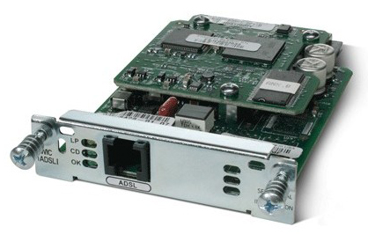
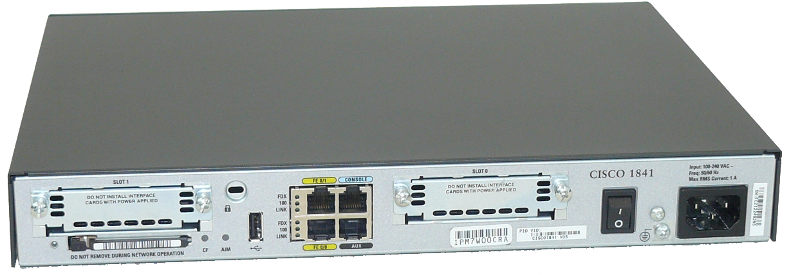
WIC-1ADSL Module
WIC-1ADSL Module is an additional module that provided with a RJ11 Interface which used to connect telephone lines. So the Cisco 1841 Router is being the ADSL Router.

Slide 20
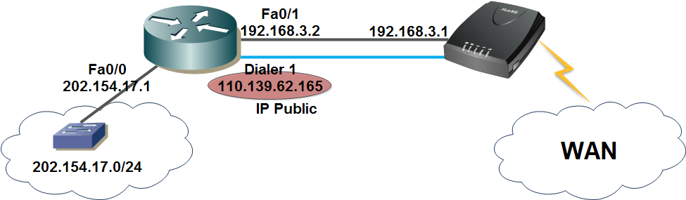
RFC 1483 Bridge
RFC 1483 Bridge is a method that bypass the IP Public to the device behind the Router.

Slide 21
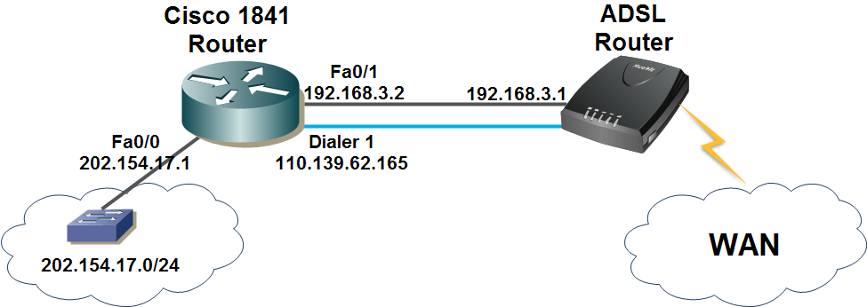
RFC 1483 Bridge
In this case, the Public IP that provides by the ISP is received by Cisco 1841 Router behind the ADSL Router.

Slide 22
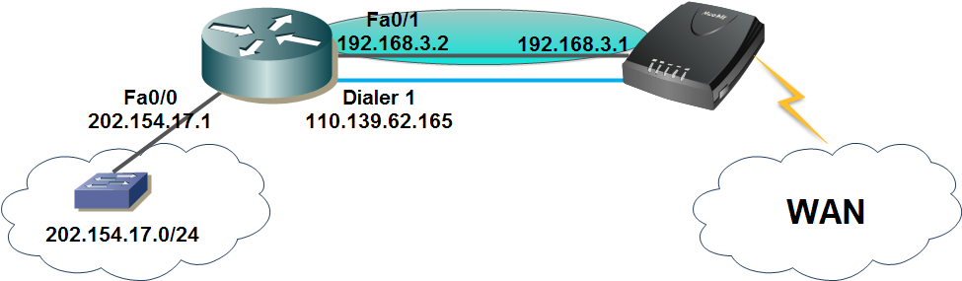
RFC 1483 Bridge
Despite the connection between the Cisco 1841 Router and ADSL Router is a private network.

Slide 23
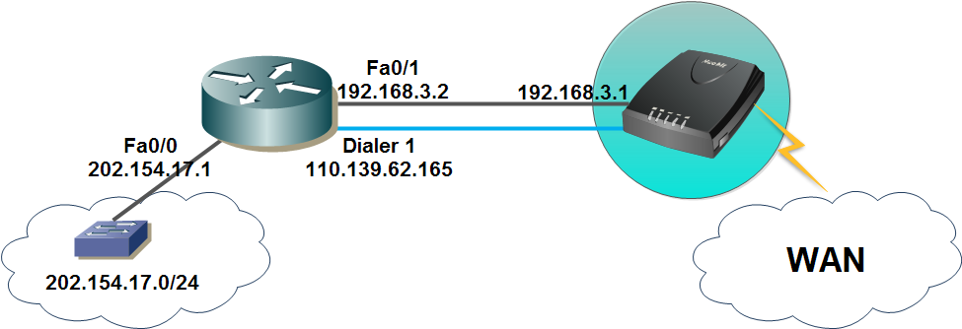
RFC 1483 Bridge
So the ADSL Router role is just to facilitate the ADSL Modulation between Cisco 1841 Router and telephone lines.

Slide 24
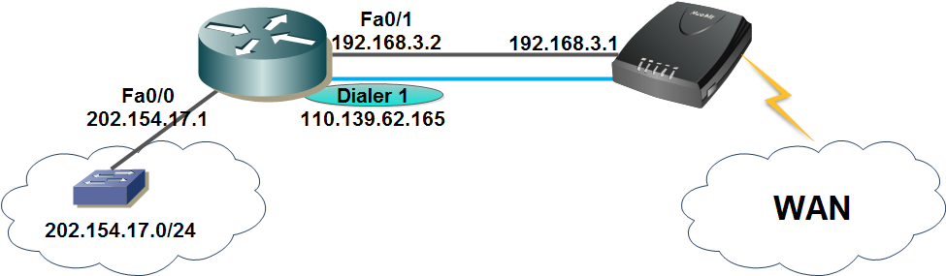
RFC 1483 Bridge
Then by using a Dialer Interface, Cisco 1841 Router can dial the ISP and get the Public IP.

Slide 25
Implementation on ADSL
On STTS side:
Create a Virtual Private Dialer Network
Configure Interface Fa0/1 as WAN Interface
Configure Dialer Interface
Configure ISP Credential
Configure Routing (RIP)
Configure IPsec components and transform set
Define Access Control List
Applying Crypto Map
Notes:
Virtual Private Dialer Network is a logical interface that will used by the router for dial to the ISP
-
Configure Dialer interface to be embedded on WAN Interface (which means Fa0/1)
Configure the ISP credential which given by the ISP such as username and password
Configure the routing, there are many routing protocols such as Static Routing, RIP, OSPF, IGRP, and EIGRP which supported by Cisco 1841, in this scenario will used RIP.
IPsec components like pre-shared key, encryption methods, hash methods, and diffie-hellman algorithm.
Access control list is usually called firewall, which give access from the remote network to access the network behind the router.
Aplly crypto map to the WAN interface.

Slide 26
Implementation on ADSL
On Remote side:
Add WIC-1ADSL module on Cisco 1841
Configure ADSL Interface
Configure Dialer Interface and ISP Credential
Configure Default Route and NAT
Configure IPsec components and transform set
Define Access Control List
Applying Crypto Map
Notes:
Like the previous peers, dialer interface is configured, but right here, the dialer interface is applied to the ADSL interface
In this peer, we used Network Address Translation instead routing, because the network behind the router is private network, and the network over the router (Interface ADSL) is public network. NAT is manually configured because on this scenario, the router is being the ADSL Router. On the stts side, NAT is configured on the Bridged ADSL Router.

Slide 27
Analysis Study
Combine the Encryption and Hash methods that provides by Cisco 1841 Router.
Test the performance between the combination and routers used on simulated WAN.
Test the security between the IPsec gateways with Wireshark.
Analyze the result into statistical method (ANOVA and Linear Regression).

Slide 28
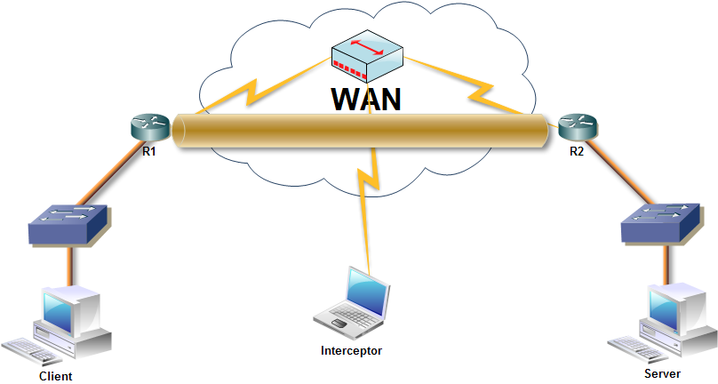
Analysis Study
Notes:
This is the scenario of the analysis study which will be practiced later.
Ass you can see, there’s two router that connected to WAN by a HUB. There’s a computer that connected to the HUB, which will represent an intruder, this my laptop will be the intruder. Both router (R1 & R2) will be acted as VPN Gateways which will create a tunnel to secure the communication. Each router will connected to separate network which will communicate inside the tunnel later.

Slide 29
Analysis Study
Performance of the network rated by the PING performance.
Security of the network rated by Packet Captured on Wireshark . The original packet is use TCP Protocol with 8080 port.
Notes:
I will show you later on the demo

Slide 30
Test Result
No | Encr | Hash | 0 Router Pass | 2 Router Pass | 6 Router Pass | Packet Detected
 |  |  | PING | PING | PING
0 | No VPN |  | 1 ms | 18 ms | 87 ms | TCP
 |  |  | 1 ms | 18 ms | 87 ms | TCP
 |  |  | 1 ms | 18 ms | 87 ms | TCP
1 | DES | SHA | 2 ms | 33 ms | 155.5 ms | ESP
 |  |  | 1.5 ms | 33.5 ms | 168.5 ms | ESP
 |  |  | 2 ms | 33 ms | 164 ms | ESP
2 | DES | MD5 | 2 ms | 33 ms | 155 ms | ESP
 |  |  | 2 ms | 35 ms | 158 ms | ESP
 |  |  | 2 ms | 33 ms | 157.5 ms | ESP
3 | 3DES | SHA | 2 ms | 33 ms | 155.5 ms | ESP
 |  |  | 1.5 ms | 33 ms | 154.5 ms | ESP
 |  |  | 2 ms | 32.5 ms | 155 ms | ESP
4 | 3DES | MD5 | 2 ms | 32 ms | 155.5 ms | ESP
 |  |  | 2 ms | 33 ms | 159 ms | ESP
 |  |  | 1.5 ms | 33 ms | 155 ms | ESP
5 | AES | SHA | 2 ms | 35 ms | 165.5 ms | ESP
 |  |  | 1.5 ms | 35.5 ms | 166.5 ms | ESP
 |  |  | 2 ms | 35 ms | 165.5 ms | ESP
6 | AES | MD5 | 2 ms | 35 ms | 166 ms | ESP
 |  |  | 2 ms | 35 ms | 166 ms | ESP
 |  |  | 1.5 ms | 35 ms | 165.5 ms | ESP
Notes:
By the analysis which I did, this is the result of the analysis.
As you can see the performance, represented by the PING speed is varied by the encryption, hash, and router sum used on WAN.

Slide 31
Analysis of Variance
Source | Type III Sum of Squares | df | Mean Square | F | F_{t} | Sig.
Router | 253145.148 | 2 | 126572.574 | 37349.284 | 3.26 | .000
Hash | .907 | 1 | .907 | .268 | 4.11 | .608
Enkripsi | 165.148 | 2 | 82.574 | 24.366 | 3.26 | .000
Router * Hash | 4.704 | 2 | 2.352 | .694 | 3.26 | .506
Router * Enkripsi | 164.852 | 4 | 41.213 | 12.161 | 2.63 | .000
Hash * Enkripsi | 10.037 | 2 | 5.019 | 1.481 | 3.26 | .241
Router * Hash * Enkripsi | 33.519 | 4 | 8.380 | 2.473 | 2.63 | .062
Error | 122.000 | 36 | 3.389
Total | 484273.000 | 54
Dependent Variable:PING a. R Squared = 1.000 (Adjusted R Squared = .999)
Notes:
This is the result from anova operation which generated by the SPSS 17.0
Type III – marginal squares from the number of the factor
Df – degree of freedom
Mean square – type III / df
F – mean square / mean square error
Error – difference between sum of the computed factor with the real data
The factor make the effect if Computed F is greater than Tabled F.

Slide 32
Analysis of Variance Result
VPN Performance affected by Encryption Method used, Router sum on the WAN, and the interaction between them.
Hash method doesn’t affect the VPN Performance.

Slide 33
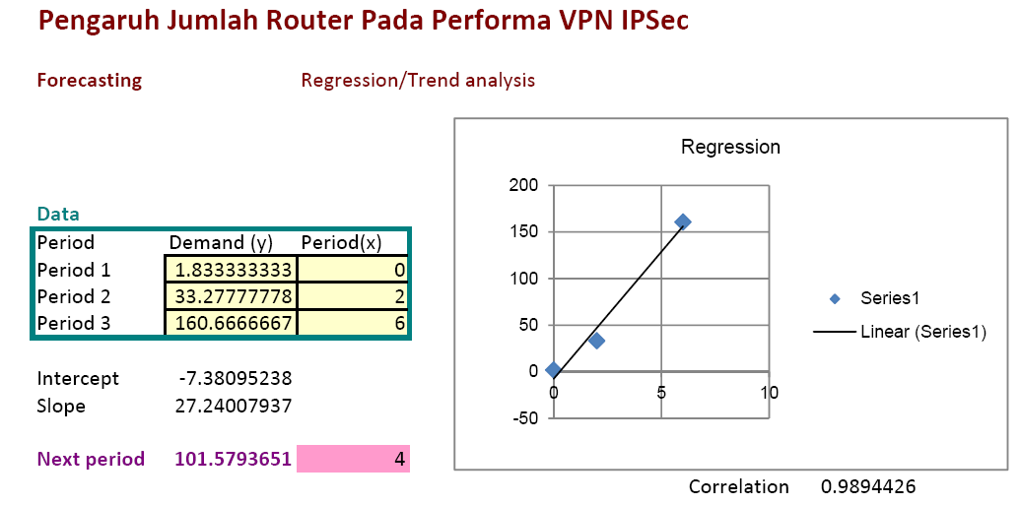
Linear Regression
From the result table, and use a simple linear regression, can be summarized an equation which show the relation between router on WAN, with performance of VPN Connection made.
Y = -7.38 + 27.24(X)

Slide 34
Linear Regression
Y = -7.38 + 27.24(X)
Y = PING Performance
X = Router Passed on WAN

Slide 35
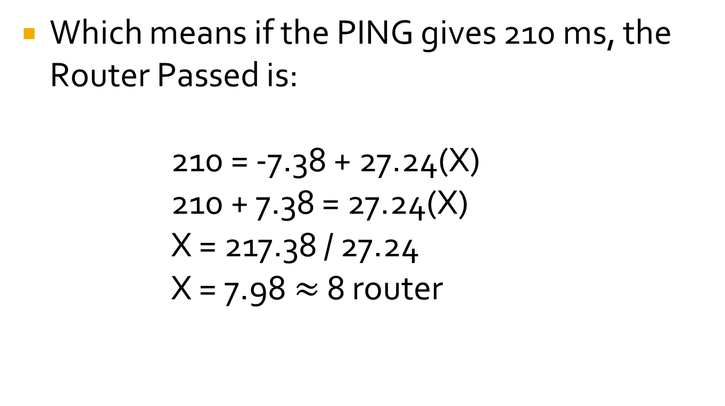
Linear Regression
Which means if the PING gives 210 ms, the Router Passed is:
210 = -7.38 + 27.24(X)
210 + 7.38 = 27.24(X)
X = 217.38 / 27.24
X = 7.98$≈$ 8 router

Slide 36
Conclusion
Cisco 1841 Router support VPN Technology on ADSL Line, with WIC-1ADSL or RFC 1483 Bridge. Applied with Dialer Interface on each router.
VPN Performance affected by Encryption Methods, Router Sum on WAN and the interaction between them. The association described with formula “Y = -7.38 + 27.24(X)”.

Slide 37
Conclusion
With VPN IPsec, network performance reduced by 44.44% than normal network (without VPN).
With a low cost, VPN is more suitable to be applied on small to medium business, with 44.44% reduced performance consequences.

Slide 38

Thank You,…
FIN

